Slide 1



JOURNEY MAP
HOW TO USE?
BOOTCAMP ONE | DAY THREE
HCD EXERCISE | DEFINE
OUTLINE THE USER JOURNEY
Details | Step 1 | Step 2 | Step 3 | Step 4 | Step 5 | Step 6
What do users do?
What do users like?
What do users not like?
What are some opportunities to improve experience?
Objective of Exercise
To map user actions, and key moments of delight and pain in an end to end user journey. To identify opportunities for improving experience at each step.
Tools
Experience Journey Map
About ‘Journey Map’
Journey Map is a tool that has grown in significance as experience has become centre stage in businesses, and it becomes important to think of solutions as end to end. Each journey has steps. At each of these steps there are user actions, and things users like or dislike - which provide opportunities to improve experience.
1
2
Journey Steps
Review: The different journey steps and choose the ones most relevant to the context.
User Actions
Note down: The key actions from the user/customer.
3
4
5
Delights
Note down: The key moments and factors of delight for the user in the current experience.
Pain Points
Note down: The key moments and factors of pain for the user in the current experience.
Opportunities
Note down: The key opportunities that seem to emerge with regards to improving experience.
*
More than One Journey
Different kinds of users/customers may be going through different kinds of journeys. These journeys and types of users/customers need to identified. The nature and cause of difference in journeys can be highly insightful.
Journey Maps - Service Safari
Journey maps are used as a research tool during Service Safaris (and even in discussions with users if needed). The findings from those exercises can be brought straight into consideration here.
FINANCIAL INNOVATION LAB | BOOTCAMP ONE

Slide 2
BOOTCAMP ONE | DAY THREE
HCD EXERCISE | DEFINE
OUTLINE THE USER JOURNEY
Notes
Session Flow
Sharing the Objective | 2 Min
Facilitators to share the objective of the session/exercise.
Walkthrough - Example | 5 Min
Facilitators to walk through 1-2 examples of the tool in use.
Walkthrough - ‘How To?’ | 5 Min
Facilitators to walk through the ‘How to?’ of the tool as per instructions on the toolsheet.
Clarifications | 3 Min
Facilitators to clarify doubts from participants.
Exercise | 30 Min
Participants to use tool with guidance from the facilitation team. A recommended flow could be -
Considering Steps - 5 Min
Fill User Actions, Likes, Dislikes - 15 Min
Refine and Consider Opportunities - 10 Min
Points to Consider
The numbering provided in the How To? is a recommended path. Startups may still choose to fill the template as per their convenience.
Journeys steps can vary for different types of services. The steps decided on need to match the experience of use.
Experiences for different types of users differ from each other. These differences can be highly insightful in finding opportunities for solutions.
Journeys can be macro/high level or micro/detailed - a team has to take a call on what kind of journey to focus on.
Journeys can be experiences only from the physical world, or they could be online, or both.
Opportunities do not need to be specific ideas but just areas that need to be worked on.
Organisational processes and systems - front and back end can be mapped on a journey to better see how the front end is impacted by back end structures.
Tools
Experience Journey Map
Material
Template, Chart Paper, Post-Its, Pens/ Sketch Pens
Time
45 Minutes
FINANCIAL INNOVATION LAB | BOOTCAMP ONE

Slide 3
TOOL: EXPERIENCE JOURNEY MAP
Details | Step 1 | Step 2 | Step 3 | Step 4 | Step 5 | Step 6
What do users do?
What do users like?
What do users not like?
What are some opportunities to improve experience?
FINANCIAL INNOVATION LAB | BOOTCAMP ONE

Slide 4
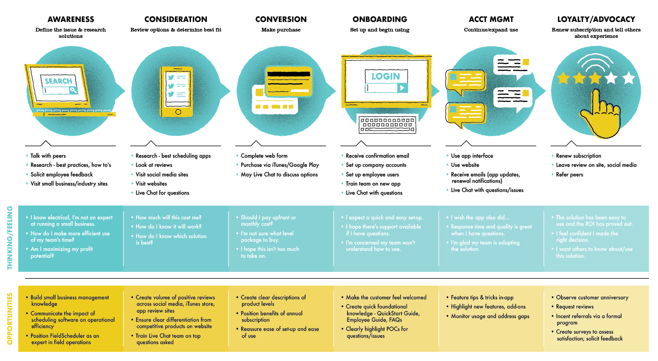
TOOL: EXPERIENCE JOURNEY MAP
FINANCIAL INNOVATION LAB | BOOTCAMP ONE

Slide 5
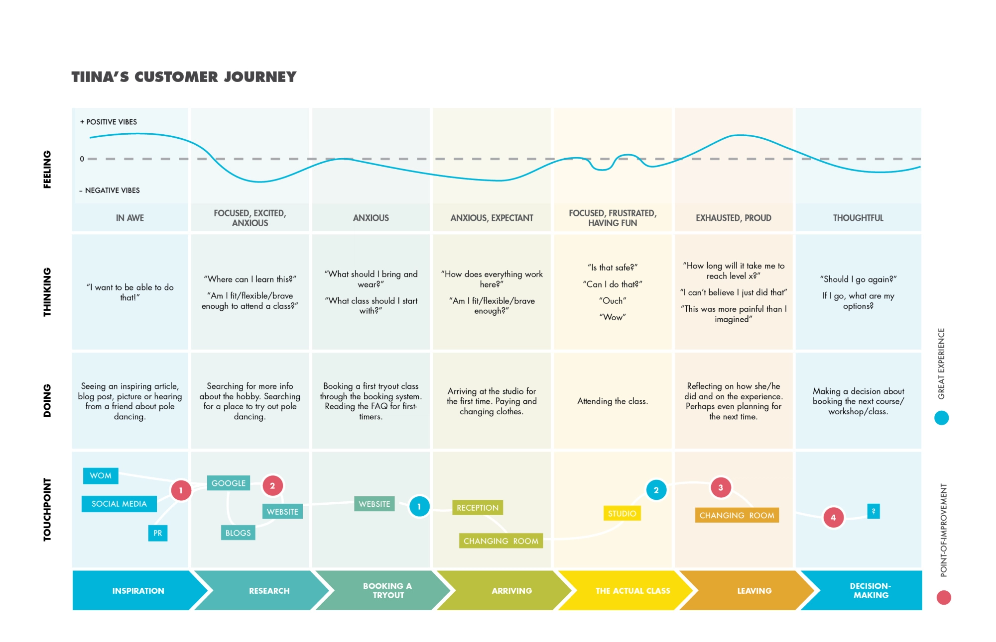
TOOL: EXPERIENCE JOURNEY MAP
FINANCIAL INNOVATION LAB | BOOTCAMP ONE

